Slide 1
Multidimensional Arrays

Slide 2
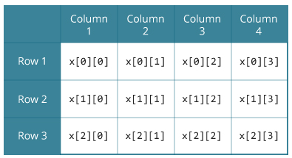
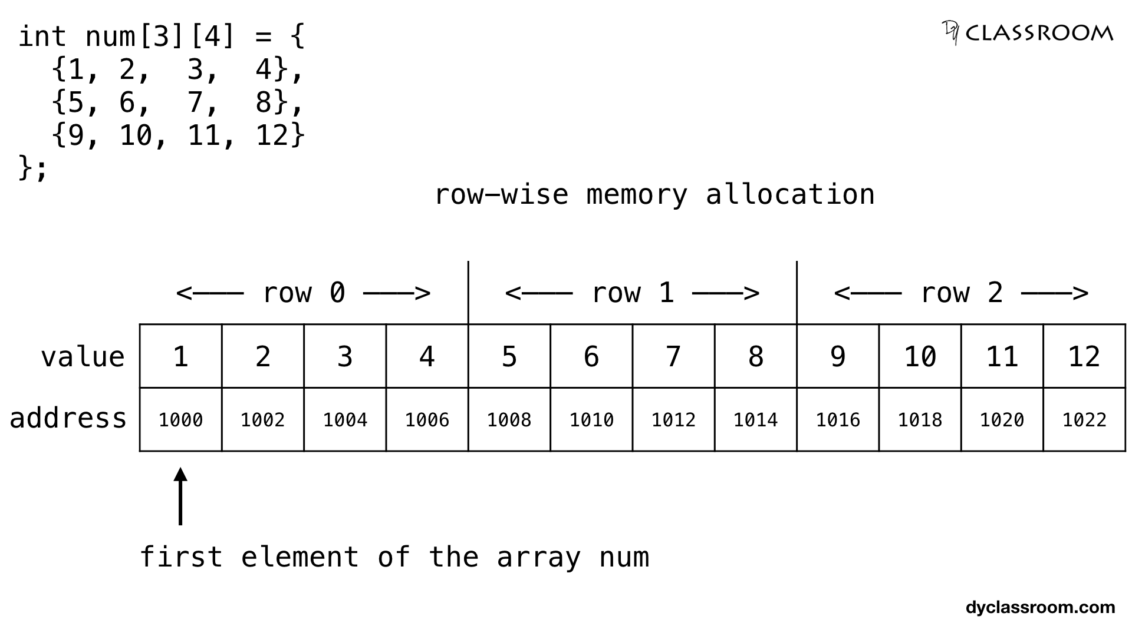
Multidimensional arrays
num[rows][cols]
1 | 2 | 3 | 4
5 | 6 | 7 | 8
9 | 10 | 11 | 12

Slide 3
Multidimensional arrays
#define ROWS 2
#define COLS 3
int mat[ROWS][COLS] = {{1, 2, 3},
{4, 5, 6}};
still in one contiguous block of memory! looks like a 1d array...
1 | 2 | 3 | 4 | 5 | 6 | ??? | ??? | ??? | ???
mat[0][0]
mat[0][1]
mat[0][2]
mat[1][0]
mat[1][1]
mat[1][2]

Slide 4
Multidimensional arrays
#define ROWS 2
#define COLS 3
int mat[ROWS][COLS] = {{1, 2, 3},
{4, 5, 6}};
int arr[ROWS*COLS] = {1, 2, 3, 4, 5, 6};
Same use of memory, just different indexing.
Can we index a 2d array like a 1d array?
1 | 2 | 3 | 4 | 5 | 6 | ??? | ??? | ??? | ???
arr[0]
arr[1]
arr[2]
arr[3]
arr[4]
arr[5]
mat[0][0]
mat[0][1]
mat[0][2]
mat[1][0]
mat[1][1]
mat[1][2]

Slide 5
Multidimensional arrays
#define ROWS 2
#define COLS 3
int mat[ROWS][COLS] = {{1, 2, 3},
{4, 5, 6}};
int arr[ROWS*COLS] = {1, 2, 3, 4, 5, 6};
int *p = matrix[0]; // p -> mat[0][0] (arr[0])
1 | 2 | 3 | 4 | 5 | 6 | ??? | ??? | ??? | ???
arr[0]
arr[1]
arr[2]
arr[3]
arr[4]
arr[5]
mat[0][0]
*(p+0)
mat[0][1]
*(p+1)
mat[0][2]
*(p+2)
mat[1][0]
*(p+3)
mat[1][1]
*(p+4)
mat[1][2]
*(p+5)
remember: p[0] is syntactic sugar for *(p+0)

Slide 6
Multidimensional arrays
Can we do:
int mat[][] = {1, 2, 3, 4, 5, 6, 7, 8};

Slide 7
Multidimensional arrays
Can we do:
int mat[][] = {1, 2, 3, 4, 5, 6, 7, 8};
No. We don’t know how the array is set up.
Where would mat[1][0] be?
It could be 3 <= int mat[4][2] : {{1, 2}, {3, 4}, {5, 6}, {7, 8}}
or 5 <= int mat[2][4] : {{1, 2, 3, 4}, {5, 6, 7, 8}}

Slide 8
Indexing 2d arrays
int A[N][M] = {{1,2},
{3,4},
{5,6},
{7,8}}; // N=4 rows, M=2 cols
// Prints a 2D array
for (int i = 0; i < N; ++i) {
for (int j = 0; j < M; ++j) {
printf("%d ", A[i][j])
}
}

Slide 9
Print 2d int array
void print_int_array(int arr[], int n) {
for (int i = 0; i < n; i++) printf(“%3d “, arr[i]);
}
void print_2d_int_array(int mat[][COLS], int rows) {
for (int i = 0; i < rows; i++) {
print_int_array(mat[i], COLS);
printf(“\n”);
}
}
We must give dimensions for all but first dimension.
Why? mat[0] is of type int[COLS]. So mat is of type int[COLS] *.
If mat[0] had variable length, it would have type int *. Mat would be int **. No memory allocated.

Slide 10
Set all entries in 2D array to k.
void set_all_to_k(int A[][N], int m, int k) {
for (int i = 0; i < N; i++)
for (int j = 0; j < m; j++)
A[i][j] = k;
}
Or
void set_all_to_k(int A[][N], int m, int k) {
for (int i = 0; i < N*m; i++) *(A[0] + i) = k;
}

Slide 11
Copy rows
memcpy(mat+j, mat+i, M * sizeof(int));
copies the ith row of mat to the jth row of mat.
each row of mat has length M.
Exercise: write a function that does this yourself.
Note: copying / manipulating columns is trickier!

Slide 12
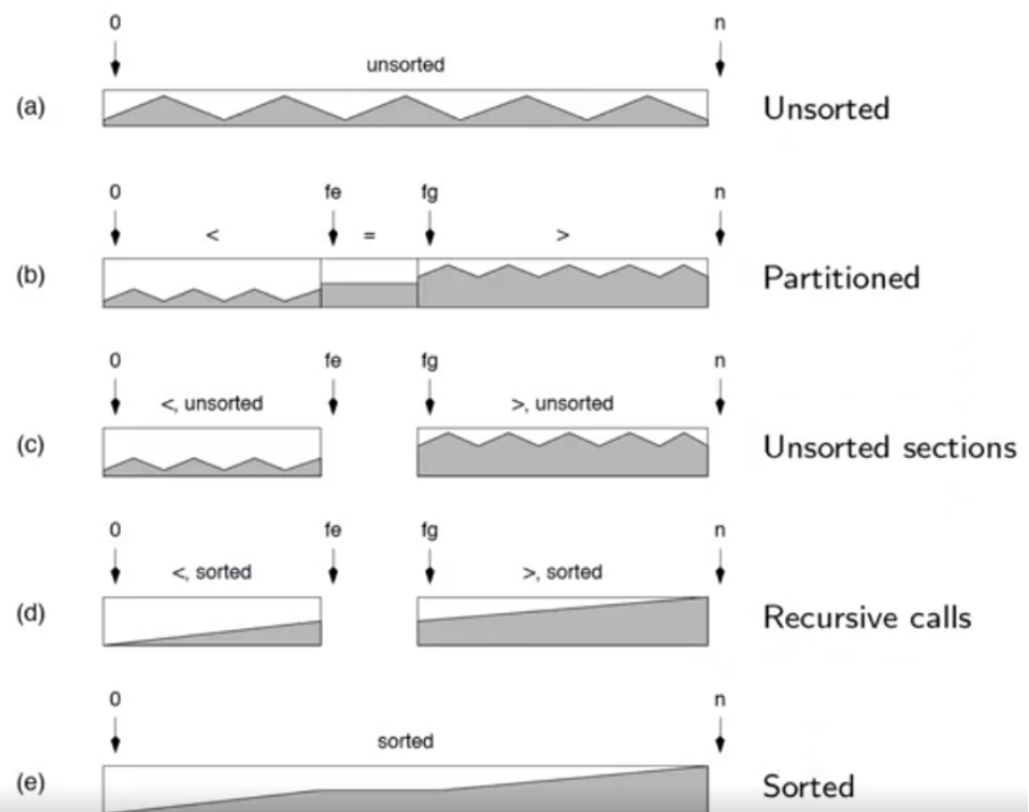
Quicksort (Hoare, 1959)
Recursively partition array so that we have ‘smaller’ items on the left of our ‘pivot’ and ‘larger’ items on the right of our pivot.

Slide 13
Quicksort Implementation
void quicksort(int *A, int n){
if (n <= 1) return; // base case -- sorted
int fe, fg; // index: first equal=, first greater>
int pivot = choose_pivot(A); // pick a pivot (value)
partition(A, n, &fe, &fg, pivot); // partition the array. (b)
quicksort(A, fe); // length of 1st partition: fe
quicksort(A + fg, n - fg); // length of 2nd partition: (n - fg)
// equals are in place -- we’re done!
}

Slide 14
Quicksort
void quicksort(int *A, int n){
if (n <= 1) return; // base case -- sorted
int fe, fg; // "first equal =", "first greater >"
int pivot = choose_pivot(A); // pick a pivot (value of the pivot, not index)
partition(A, n, &fe, &fg, pivot); // partition the array. O(n)
quicksort(A, fe); // length of first partition is index of fe
quicksort(A + fg, n - fg); // length of second partition is size n - index of fg
// equals are in place -- we’re done!
}
9 | 6 | 5 | 3 | 2 | 8 | 7 | 2 | 5
<
=
>
2 | 3 | 2 | 5 | 5 | 7 | 8 | 6 | 9
^fe
^fg
Now run quicksort on both partitions.

Slide 15
9 | 6 | 5 | 3 | 2 | 8 | 7 | 2 | 5
Note: the resulting order within each partition (red / orange) doesn’t matter - it depends on the partition scheme used. Here I’m using Hoare from the lectures, so I get this order.
Partition:
<
=
>
2 | 3 | 2 | 5 | 5 | 7 | 8 | 6 | 9
^fe
^fg
<
=
<
=
>
2 | 2 | 3
6 | 7 | 9 | 8
=
<empty>
=
=
>
2 | 2
6
8 | 9
<empty>
<empty>
<empty>
=
<empty>
<empty>
9
Result:
2 | 2 | 3 | 5 | 5 | 6 | 7 | 8 | 9
<empty>
<empty>

Slide 16
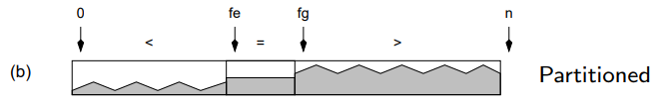
Quicksort (Hoare, 1959)
Recursively partition array so that we have ‘smaller’ items on the left of our ‘pivot’ and ‘larger’ items on the right of our pivot.
0. Base case: if the array has 0 or 1 elements, it is sorted.
Pick a pivot. (to partition the array with)
Partition the array into <smaller>, <equal> and <greater> partitions.
Recurse: quicksort the <smaller> partition, and quicksort the <greater> partition.

Slide 17
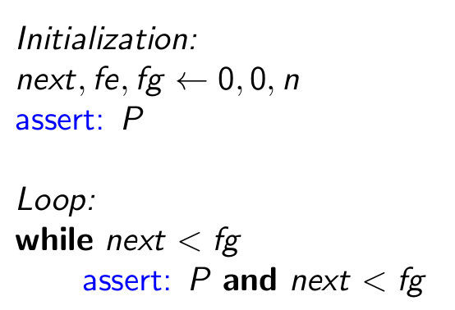
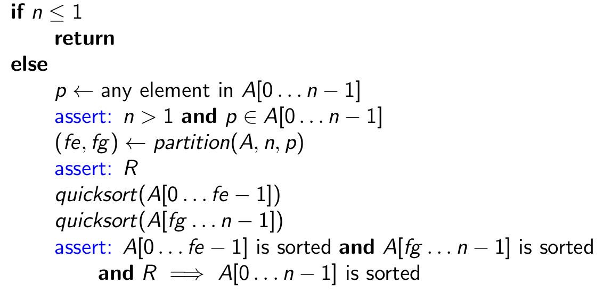
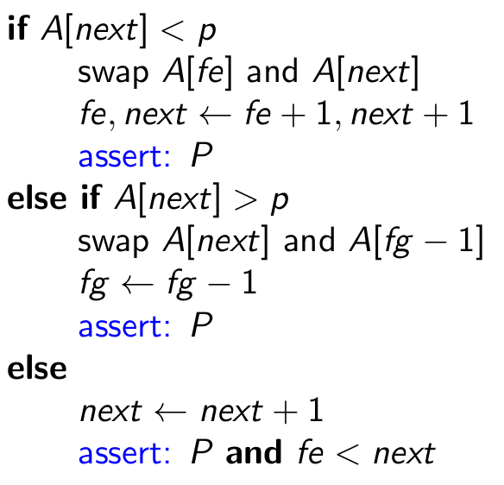
Quicksort Correctness
Quicksort: Partition:
p: pivot

Slide 18
Hoare Partitioning Implementation
void partition(int *A, int n, int* fe, int* fg, int pivot) {
int next = 0; // next item to partition
*fe = 0; // first equals, will go ->
*fg = n; // first greater, will go <-
while (next < *fg) {
if (A[next] < pivot) {
int_swap(A + *fe, A + next);
(*fe)++; next++;
}
else if (A[next] > pivot) {
(*fg)--;
int_swap(A + *fg, A + next);
}
else { // if (A[next] == pivot)
next++;
}
}
}
<
=
v next
>
< | < | < | = | = | ? | ? | > | > | >
^fe
^fg
0
n

Slide 19
Hoare Partitioning Implementation
void partition(int *A, int n, int* fe, int* fg, int pivot) {
int next = 0; // next item to partition
*fe = 0; // first equals, will go ->
*fg = n; // first greater, will go <-
while (next < *fg) {
if (A[next] < pivot) {
int_swap(A + *fe, A + next);
(*fe)++; next++;
}
else if (A[next] > pivot) {
(*fg)--;
int_swap(A + *fg, A + next);
}
else { // if (A[next] == pivot)
next++;
}
}
}
Pivot: 5
v next
9 | 6 | 5 | 3 | 2 | 8 | 7 | 2 | 5
^fe
^fg

Slide 20
Hoare Partitioning Implementation
void partition(int *A, int n, int* fe, int* fg, int pivot) {
int next = 0; // next item to partition
*fe = 0; // first equals, will go ->
*fg = n; // first greater, will go <-
while (next < *fg) {
if (A[next] < pivot) {
int_swap(A + *fe, A + next);
(*fe)++; next++;
}
else if (A[next] > pivot) {
(*fg)--;
int_swap(A + *fg, A + next);
}
else { // if (A[next] == pivot)
next++;
}
}
}
Pivot: 5
v next
9 > 5
9 | 6 | 5 | 3 | 2 | 8 | 7 | 2 | 5
^fe
^fg

Slide 21
Hoare Partitioning Implementation
void partition(int *A, int n, int* fe, int* fg, int pivot) {
int next = 0; // next item to partition
*fe = 0; // first equals, will go ->
*fg = n; // first greater, will go <-
while (next < *fg) {
if (A[next] < pivot) {
int_swap(A + *fe, A + next);
(*fe)++; next++;
}
else if (A[next] > pivot) {
(*fg)--;
int_swap(A + *fg, A + next);
}
else { // if (A[next] == pivot)
next++;
}
}
}
Pivot: 5
v next
>
9 > 5
5 | 6 | 5 | 3 | 2 | 8 | 7 | 2 | 9
^fe
^fg

Slide 22
Hoare Partitioning Implementation
void partition(int *A, int n, int* fe, int* fg, int pivot) {
int next = 0; // next item to partition
*fe = 0; // first equals, will go ->
*fg = n; // first greater, will go <-
while (next < *fg) {
if (A[next] < pivot) {
int_swap(A + *fe, A + next);
(*fe)++; next++;
}
else if (A[next] > pivot) {
(*fg)--;
int_swap(A + *fg, A + next);
}
else { // if (A[next] == pivot)
next++;
}
}
}
Pivot: 5
v next
>
5 = 5
5 | 6 | 5 | 3 | 2 | 8 | 7 | 2 | 9
^fe
^fg

Slide 23
Hoare Partitioning Implementation
void partition(int *A, int n, int* fe, int* fg, int pivot) {
int next = 0; // next item to partition
*fe = 0; // first equals, will go ->
*fg = n; // first greater, will go <-
while (next < *fg) {
if (A[next] < pivot) {
int_swap(A + *fe, A + next);
(*fe)++; next++;
}
else if (A[next] > pivot) {
(*fg)--;
int_swap(A + *fg, A + next);
}
else { // if (A[next] == pivot)
next++;
}
}
}
Pivot: 5
=
v next
>
5 = 5
5 | 6 | 5 | 3 | 2 | 8 | 7 | 2 | 9
^fe
^fg

Slide 24
Hoare Partitioning Implementation
void partition(int *A, int n, int* fe, int* fg, int pivot) {
int next = 0; // next item to partition
*fe = 0; // first equals, will go ->
*fg = n; // first greater, will go <-
while (next < *fg) {
if (A[next] < pivot) {
int_swap(A + *fe, A + next);
(*fe)++; next++;
}
else if (A[next] > pivot) {
(*fg)--;
int_swap(A + *fg, A + next);
}
else { // if (A[next] == pivot)
next++;
}
}
}
Pivot: 5
=
v next
>
6 > 5
5 | 6 | 5 | 3 | 2 | 8 | 7 | 2 | 9
^fe
^fg

Slide 25
Hoare Partitioning Implementation
void partition(int *A, int n, int* fe, int* fg, int pivot) {
int next = 0; // next item to partition
*fe = 0; // first equals, will go ->
*fg = n; // first greater, will go <-
while (next < *fg) {
if (A[next] < pivot) {
int_swap(A + *fe, A + next);
(*fe)++; next++;
}
else if (A[next] > pivot) {
(*fg)--;
int_swap(A + *fg, A + next);
}
else { // if (A[next] == pivot)
next++;
}
}
}
Pivot: 5
=
v next
>
6 > 5
5 | 2 | 5 | 3 | 2 | 8 | 7 | 6 | 9
^fe
^fg

Slide 26
Hoare Partitioning Implementation
void partition(int *A, int n, int* fe, int* fg, int pivot) {
int next = 0; // next item to partition
*fe = 0; // first equals, will go ->
*fg = n; // first greater, will go <-
while (next < *fg) {
if (A[next] < pivot) {
int_swap(A + *fe, A + next);
(*fe)++; next++;
}
else if (A[next] > pivot) {
(*fg)--;
int_swap(A + *fg, A + next);
}
else { // if (A[next] == pivot)
next++;
}
}
}
Pivot: 5
=
v next
>
2 < 5
5 | 2 | 5 | 3 | 2 | 8 | 7 | 6 | 9
^fe
^fg

Slide 27
Hoare Partitioning Implementation
void partition(int *A, int n, int* fe, int* fg, int pivot) {
int next = 0; // next item to partition
*fe = 0; // first equals, will go ->
*fg = n; // first greater, will go <-
while (next < *fg) {
if (A[next] < pivot) {
int_swap(A + *fe, A + next);
(*fe)++; next++;
}
else if (A[next] > pivot) {
(*fg)--;
int_swap(A + *fg, A + next);
}
else { // if (A[next] == pivot)
next++;
}
}
}
Pivot: 5
<
=
v next
>
2 < 5
2 | 5 | 5 | 3 | 2 | 8 | 7 | 6 | 9
^fe
^fg

Slide 28
Hoare Partitioning Implementation
void partition(int *A, int n, int* fe, int* fg, int pivot) {
int next = 0; // next item to partition
*fe = 0; // first equals, will go ->
*fg = n; // first greater, will go <-
while (next < *fg) {
if (A[next] < pivot) {
int_swap(A + *fe, A + next);
(*fe)++; next++;
}
else if (A[next] > pivot) {
(*fg)--;
int_swap(A + *fg, A + next);
}
else { // if (A[next] == pivot)
next++;
}
}
}
Pivot: 5
<
=
v next
>
5 = 5
2 | 5 | 5 | 3 | 2 | 8 | 7 | 6 | 9
^fe
^fg

Slide 29
Hoare Partitioning Implementation
void partition(int *A, int n, int* fe, int* fg, int pivot) {
int next = 0; // next item to partition
*fe = 0; // first equals, will go ->
*fg = n; // first greater, will go <-
while (next < *fg) {
if (A[next] < pivot) {
int_swap(A + *fe, A + next);
(*fe)++; next++;
}
else if (A[next] > pivot) {
(*fg)--;
int_swap(A + *fg, A + next);
}
else { // if (A[next] == pivot)
next++;
}
}
}
Pivot: 5
<
=
v next
>
5 = 5
2 | 5 | 5 | 3 | 2 | 8 | 7 | 6 | 9
^fe
^fg

Slide 30
Hoare Partitioning Implementation
void partition(int *A, int n, int* fe, int* fg, int pivot) {
int next = 0; // next item to partition
*fe = 0; // first equals, will go ->
*fg = n; // first greater, will go <-
while (next < *fg) {
if (A[next] < pivot) {
int_swap(A + *fe, A + next);
(*fe)++; next++;
}
else if (A[next] > pivot) {
(*fg)--;
int_swap(A + *fg, A + next);
}
else { // if (A[next] == pivot)
next++;
}
}
}
Pivot: 5
<
=
v next
>
3 < 5
2 | 5 | 5 | 3 | 2 | 8 | 7 | 6 | 9
^fe
^fg

Slide 31
Hoare Partitioning Implementation
void partition(int *A, int n, int* fe, int* fg, int pivot) {
int next = 0; // next item to partition
*fe = 0; // first equals, will go ->
*fg = n; // first greater, will go <-
while (next < *fg) {
if (A[next] < pivot) {
int_swap(A + *fe, A + next);
(*fe)++; next++;
}
else if (A[next] > pivot) {
(*fg)--;
int_swap(A + *fg, A + next);
}
else { // if (A[next] == pivot)
next++;
}
}
}
Pivot: 5
<
=
v next
>
3 < 5
2 | 3 | 5 | 5 | 2 | 8 | 7 | 6 | 9
^fe
^fg

Slide 32
Hoare Partitioning Implementation
void partition(int *A, int n, int* fe, int* fg, int pivot) {
int next = 0; // next item to partition
*fe = 0; // first equals, will go ->
*fg = n; // first greater, will go <-
while (next < *fg) {
if (A[next] < pivot) {
int_swap(A + *fe, A + next);
(*fe)++; next++;
}
else if (A[next] > pivot) {
(*fg)--;
int_swap(A + *fg, A + next);
}
else { // if (A[next] == pivot)
next++;
}
}
}
Pivot: 5
<
=
v next
>
2 < 5
2 | 3 | 5 | 5 | 2 | 8 | 7 | 6 | 9
^fe
^fg

Slide 33
Hoare Partitioning Implementation
void partition(int *A, int n, int* fe, int* fg, int pivot) {
int next = 0; // next item to partition
*fe = 0; // first equals, will go ->
*fg = n; // first greater, will go <-
while (next < *fg) {
if (A[next] < pivot) {
int_swap(A + *fe, A + next);
(*fe)++; next++;
}
else if (A[next] > pivot) {
(*fg)--;
int_swap(A + *fg, A + next);
}
else { // if (A[next] == pivot)
next++;
}
}
}
Pivot: 5
<
=
v next
>
2 < 5
2 | 3 | 2 | 5 | 5 | 8 | 7 | 6 | 9
^fe
^fg

Slide 34
Hoare Partitioning Implementation
void partition(int *A, int n, int* fe, int* fg, int pivot) {
int next = 0; // next item to partition
*fe = 0; // first equals, will go ->
*fg = n; // first greater, will go <-
while (next < *fg) {
if (A[next] < pivot) {
int_swap(A + *fe, A + next);
(*fe)++; next++;
}
else if (A[next] > pivot) {
(*fg)--;
int_swap(A + *fg, A + next);
}
else { // if (A[next] == pivot)
next++;
}
}
}
Pivot: 5
<
=
v next
>
8 > 5
2 | 3 | 2 | 5 | 5 | 8 | 7 | 6 | 9
^fe
^fg

Slide 35
Hoare Partitioning Implementation
void partition(int *A, int n, int* fe, int* fg, int pivot) {
int next = 0; // next item to partition
*fe = 0; // first equals, will go ->
*fg = n; // first greater, will go <-
while (next < *fg) {
if (A[next] < pivot) {
int_swap(A + *fe, A + next);
(*fe)++; next++;
}
else if (A[next] > pivot) {
(*fg)--;
int_swap(A + *fg, A + next);
}
else { // if (A[next] == pivot)
next++;
}
}
}
Pivot: 5
<
=
v next
>
8 > 5
2 | 3 | 2 | 5 | 5 | 7 | 8 | 6 | 9
^fe
^fg

Slide 36
Hoare Partitioning Implementation
void partition(int *A, int n, int* fe, int* fg, int pivot) {
int next = 0; // next item to partition
*fe = 0; // first equals, will go ->
*fg = n; // first greater, will go <-
while (next < *fg) {
if (A[next] < pivot) {
int_swap(A + *fe, A + next);
(*fe)++; next++;
}
else if (A[next] > pivot) {
(*fg)--;
int_swap(A + *fg, A + next);
}
else { // if (A[next] == pivot)
next++;
}
}
}
Pivot: 5
<
=
v next
>
7 > 5
2 | 3 | 2 | 5 | 5 | 7 | 8 | 6 | 9
^fe
^fg

Slide 37
Hoare Partitioning Implementation
void partition(int *A, int n, int* fe, int* fg, int pivot) {
int next = 0; // next item to partition
*fe = 0; // first equals, will go ->
*fg = n; // first greater, will go <-
while (next < *fg) {
if (A[next] < pivot) {
int_swap(A + *fe, A + next);
(*fe)++; next++;
}
else if (A[next] > pivot) {
(*fg)--;
int_swap(A + *fg, A + next);
}
else { // if (A[next] == pivot)
next++;
}
}
}
Pivot: 5
<
=
v next
>
7 > 5
2 | 3 | 2 | 5 | 5 | 7 | 8 | 6 | 9
^fe
^fg

Slide 38
Hoare Partitioning Implementation
void partition(int *A, int n, int* fe, int* fg, int pivot) {
int next = 0; // next item to partition
*fe = 0; // first equals, will go ->
*fg = n; // first greater, will go <-
while (next < *fg) {
if (A[next] < pivot) {
int_swap(A + *fe, A + next);
(*fe)++; next++;
}
else if (A[next] > pivot) {
(*fg)--;
int_swap(A + *fg, A + next);
}
else { // if (A[next] == pivot)
next++;
}
}
}
Pivot: 5
<
=
v next
>
2 | 3 | 2 | 5 | 5 | 7 | 8 | 6 | 9
^fe
^fg
9 | 6 | 5 | 3 | 2 | 8 | 7 | 2 | 5
Finished!
How many operations was that?

Slide 39
Hoare Partitioning Implementation
void partition(int *A, int n, int* fe, int* fg, int pivot) {
int next = 0; // next item to partition
*fe = 0; // first equals, will go ->
*fg = n; // first greater, will go <-
while (next < *fg) {
if (A[next] < pivot) {
int_swap(A + *fe, A + next);
(*fe)++; next++;
}
else if (A[next] > pivot) {
(*fg)--;
int_swap(A + *fg, A + next);
}
else { // if (A[next] == pivot)
next++;
}
}
}
Pivot: 5
<
=
v next
>
2 | 3 | 2 | 5 | 5 | 7 | 8 | 6 | 9
^fe
^fg
9 | 6 | 5 | 3 | 2 | 8 | 7 | 2 | 5
Finished!
How many operations was that?
O(n)

Slide 40
Quicksort Implementation
void quicksort(int *A, int n){
if (n <= 1) return; // base case -- sorted
int fe, fg; // "first equal =", "first greater >"
int pivot = choose_pivot(A); // pick a pivot (value of the pivot, not index)
partition(A, n, &fe, &fg, pivot); // partition the array. (b)
quicksort(A, fe); // length of first partition is index of fe
quicksort(A + fg, n - fg); // length of second partition is size n - index of fg
// equals are in place -- we’re done!
}
How does choosing a pivot change the complexity of quicksort?
What is the best choice of pivot?

Slide 41
Quicksort Performance
… depends on our choice of pivot!
eg: 2 4 6 8 7 5 3 1
Best case quicksort
sort => (< 2 3 1) (= 4) (> 7 8 6) Partitioning is n operations
sort left => (< 1) (= 2) (> 3) n/2 ops
sort left => (< ) (= 1) (> ) (done) n/4 ops
sort right => (< ) (= 3) (> ) (done) n/4 ops
sort right => (< 6) (= 7) (> 8) n/2 ops
sort left => (< ) (= 6) (> ) (done) n/4 ops
sort right => (< ) (= 8) (> ) (done) n/4 ops
Total: n + 2*n/2 + 4*n/4 = 3n = O(n log n)
(log2(8) = 3)

Slide 42
Quicksort Performance
… depends on our choice of pivot!
eg: 2 4 6 8 7 5 3 1
Worst case quicksort…? Just wait.

Slide 43
Choosing a pivot
First element
1 2 3 4 5 6 7 8
^ pivot
Any issues?

Slide 44
Choosing a pivot
First element
1 2 3 4 5 6 7 8
^ pivot
Any issues? Yep.
If the array is already sorted, we will get worst case time complexity.
Partitioning: (recall: Hoare partitioning reverses > elements)
(<) (=) 1 (>) 8 7 6 5 4 3 2
(<) 7 6 5 4 3 2 (=) 8 (>)
(<) 6 5 4 3 2 (=) 7 (>)
(<) 5 4 3 2 (=) 6 (>)
(<) 4 3 2 (=) 5 (>)
(<) 3 2 (=) 4 (>)
(<) 2 (=) 3 (>)
(<) (=) 2 (>)

Slide 45
Choosing a pivot
First element
1 2 3 4 5 6 7 8
^ pivot
Any issues? Yep.
If the array is already sorted, we will get worst case time complexity.
Partitioning: (recall: Hoare partitioning reverses > elements)
(<) (=) 1 (>) 8 7 6 5 4 3 2
(<) 7 6 5 4 3 2 (=) 8 (>)
(<) 6 5 4 3 2 (=) 7 (>)
(<) 5 4 3 2 (=) 6 (>)
(<) 4 3 2 (=) 5 (>)
(<) 3 2 (=) 4 (>)
(<) 2 (=) 3 (>)
(<) (=) 2 (>)
n partitions,
partitioning is O(n)
Total time complexity:
n * O(n) = O(n²)

Slide 46
Quicksort Complexity - Pivot choice
Pivot: choose first item
1 | 2 | 3 | 4 | 5 | 6 | 7
O(n)
1 | 2 | 3 | 4 | 5 | 6 | 7
O(n)
1 | 2 | 3 | 4 | 5 | 6 | 7
O(n)
1 | 2 | 3 | 4 | 5 | 6 | 7
O(n)
1 | 2 | 3 | 4 | 5 | 6 | 7
...
O(n)
1 | 2 | 3 | 4 | 5 | 6 | 7
n * O(n) => O(n²), worst case
This is O(n) under insertion sort!!

Slide 47
Choosing a pivot
2. Last element
Any issues?

Slide 48
Choosing a pivot
2. Last element
Any issues?
8 7 6 5 4 3 2 1
^ pivot
If the array is in reverse order, we will get worst case time complexity.
Partitioning:
(<) (=) 1 (>) 2 3 4 5 6 7 8
(<) 2 3 4 5 6 7 (=) 8 (>)
(<) 2 3 4 5 6 (=) 7 (>)
(<) 2 3 4 5 (=) 6 (>)
(<) 2 3 4 (=) 5 (>)
(<) 2 3 (=) 4 (>)
(<) 2 (=) 3 (>)
(<) (=) 2 (>)
n partitions,
partitioning is O(n)
n * O(n) = O(n²)

Slide 49
Choosing a pivot
3. Middle element
eg: 5 7 2 9 3 2 5 7
Any issues?

Slide 50
Choosing a pivot
3. Middle element
eg: 5 7 2 9 3 2 5 7
Any issues? Not with that one, but consider: 2 4 6 8 7 5 3 1
Partitioning:
(<) 2 4 6 7 5 3 1 (=) 8 (>)
(<) 2 4 6 5 3 1 (=) 7 (>)
(<) 2 4 5 3 1 (=) 6 (>)
(<) 2 4 3 1 (=) 5 (>)
(<) 2 3 1 (=) 4 (>)
(<) 2 1 (=) 3 (>)
(<) 1 (=) 2 (>)
(<) (=) 1 (>)
n partitions,
partitioning is O(n)
n * O(n) = O(n²)

Slide 51
Choosing a pivot
Seems like wherever we pick a pivot, we're always getting O(n²) some way.
Can we do better?

Slide 52
Choosing a pivot
Seems like wherever we pick a pivot, we're always getting O(n²) some way.
Can we do better?
4. Random pivot
On each partition, choose a random index in the array as the pivot.
eg: 2 4 6 8 7 5 3 1
There's a 2/n chance of choosing the worst case. (1 or 8)
There's a 2/n chance of choosing the best case. (4 or 5)
And we can have everything in between.
Turns out, this ensures O(n log n) as long as there isn't some prior distribution of the array.

Slide 53
Choosing a pivot
int choose_pivot(int *A, int n) {
return A[rand() % n]; // Random pivot (best option, why?)
// return A[0]; // first item
// return A[n-1]; // last item
// return A[n/2]; // middle item
}

Slide 54
Quicksort Complexity
Space Complexity:
O(n) - 2 partition; O(log n) - 3 partitions.
Time Complexity - depends on how the array is partitioned.
Best case: Pivot always splits the array in half. 9 8 7 6 5 4 3 2 1 -> choose 5.
=> O(n log n)
Worst case: Pick pivot that is largest / smallest 9 8 7 6 5 4 3 2 1 -> choose 1 or 9.
=> O(n^2)
Average case: Pivot could be anywhere in between. Proof in DoA / ADS
=> O(n log n)
Partition is O(n). We partition O(log n) times if our pivot choice is good => O(n log n).

Slide 55
Comparing sorting algorithms
 | Insertion sort | Quicksort
Idea | Builds sorted array sequentially, swapping elements towards the end | Recursively partition array into two parts, to sort independently (divide and conquer)
Notes | Easy to implement / understand. Efficient for nearly sorted arrays, and small arrays. | Complexity depends on pivot choice. Choose random pivot for best results. Hoare Partitioning is O(n)
Time Complexity | O(n) best (already sorted!) O(n²) average and worst | O(n²) worst (picking worst pivot) O(n log n) average and best.
Space Complexity | O(1) (auxiliary) | O(n) (2 partition) O(log n) (3 partition)
Notes:
What if we take the ceil instead of the floor?
Hint: try 1 1 2 4 5
but then 1 1 1 2 4 5 6

